Slide 1

Computing, Engineering
and the Built Environment
CMP5387 D3
Alex Rush, 23140056, Alex.Rush@mail.bcu.ac.uk
Daniel Roberts, Student ID 2, Student Email Address 2
Zakaria Miah, Student ID 3, Student Email Address 3
Abraham Kubrom, Student ID 4, Student Email Address 4
January 2026
Notes:
“This is our D3 project submission for CMP5387 our group was: student 1, student 2, student 3, student 4, and student 4”
Note: You should not specify their student IDs or email addresses verbally, just their names
The presence of this other info in the slide is enough.
Don’t spend too long on this slide just introduce the team members and move ahead, this shouldn’t be more than a few seconds long.

Slide 2

University Society Recommendation System
A society recommendation system based on shared communities (LGBTQ+ / Identity), Interests (Gaming, Cyber Security), and degree relationship.
Notes:
Spend only a few seconds stating the title of the project idea, don’t waste too much time on this slide it shouldn’t be more than a few seconds long.

Slide 3
Overview
This slide is hidden do not record on it, it is simply meant to divide the presentation template into sections
Notes:
Some of this section will have already been discussed in your questionnaire form submission and your planning and design document, as such keep things succinct and focus on the major important aspects you want to draw the audience’s attention to Estimated time: 2-4 minutes

Slide 4
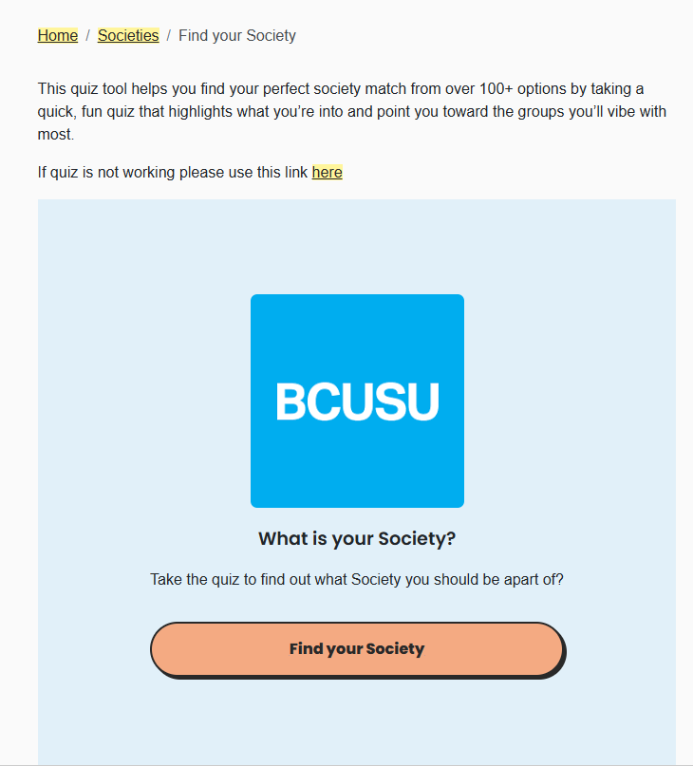
Elevator Pitch: Project Idea Summary
Presenting Team Member: Alex
Smart Society Recommendations
Students miss relevant clubs; Societies struggle to recruit and fill events; Student Union lacks discovery tools
Stakeholders:
Students (Primary)
Society Leaders (P)
Administrators (P)
Student Union (Secondary)
Developers/Maintainers (S)
Current System is either a list of all societies or a quiz to find one you "vibe" with. And the result is a long list with a lot of non-relevant societies.
Notes:
Spend no more than a minute or so on this
Students: register/login, set interests, join/unjoin societies, view recommendations and events.
Society leaders/owners: create and manage societies, add/remove leaders, create/manage events and interests.
Administrators: site-wide management (create/remove communities, manage users, override/approve actions).
University staff / Student union: oversight, reporting, policy enforcement.
Developers / Maintainers: deploy, fix, and extend the application.

Slide 5
Features Identified
Presenting Team Member: Student 4
Give a quick summary of the different core features your system should provide by showing them within a table then discussing these briefly
Feature | Description | Stakeholder(s) involved | Importance
Notes:
Spend no more than a minute or so on this

Slide 6
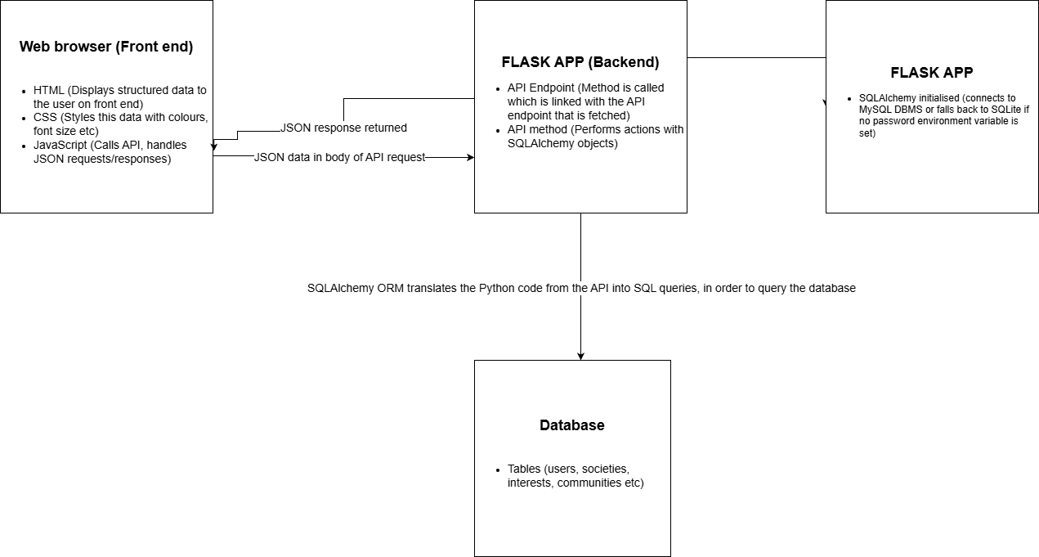
Tech Stack
Presenting Team Member: Dan
Notes:
Discuss how each part of the technology stack you and your team are using contributes to making the system work.
Consider using images / creating diagrams to help support your discussion

Slide 7
Database Design and Implementation
This slide is hidden do not record on it, it is simply meant to divide the presentation template into sections
Notes:
Estimated time: 3-6 minutes

Slide 8
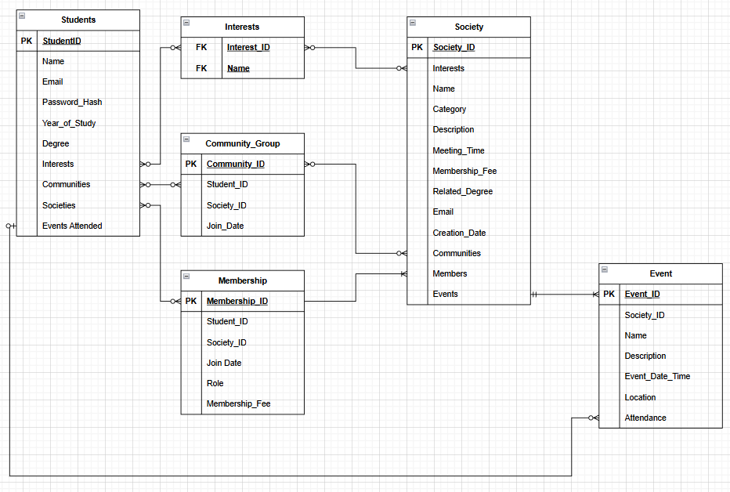
Database Design
Presenting Team Member: Abraham
The physical ERD shows the implemented relational database for the Society Recommendation System.
It uses one-to-many and many-to-many relationships, with association tables to ensure data integrity, normalisation, and support for personalised recommendations.
Notes:
Justify your database design approach
How are you:
Capturing all the data necessary for the system?
Minimising duplication?
Providing a flexible structure which could be extended in the future?

Slide 9
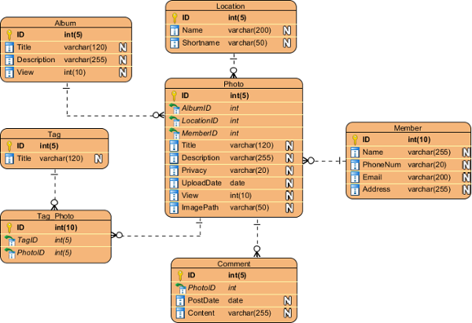
Database Implementation
Presenting Team Member: Dan
Show sample SQL DDL statements in this block and discuss the implementation decisions made
If you wish to draw attention to multiple blocks of important code then use multiple slides / an embedded video
Use this as an opportunity for each student to demonstrate how they contributed towards the DB design / implementation
Each of you should demonstrate the learning outcome:
Design and construct a well justified and appropriate Database architecture, using an appropriate assortment of query languages and tools on a host DBMS (e.g. SQL for RDBMS system, GQL/Cypher for GDBMS, etc)
Notes:
Discuss the implementation, linking the code with the physical design

Slide 10
Database Implementation
Presenting Team Member: Alex
Show sample SQL DML statements which insert data into the database within this block and discuss the implementation decisions made
If you wish to draw attention to multiple blocks of important code then use multiple slides / an embedded video
Use this as an opportunity for each student to demonstrate how they contributed towards the DB design / implementation
Each of you should demonstrate the learning outcome:
Design and construct a well justified and appropriate Database architecture, using an appropriate assortment of query languages and tools on a host DBMS (e.g. SQL for RDBMS system, GQL/Cypher for GDBMS, etc)
Notes:
Discuss the implementation, linking the code with the physical design

Slide 11
Web Service Design and Implementation
This slide is hidden do not record on it, it is simply meant to divide the presentation template into sections
Notes:
Estimated time: 3-6 minutes

Slide 12
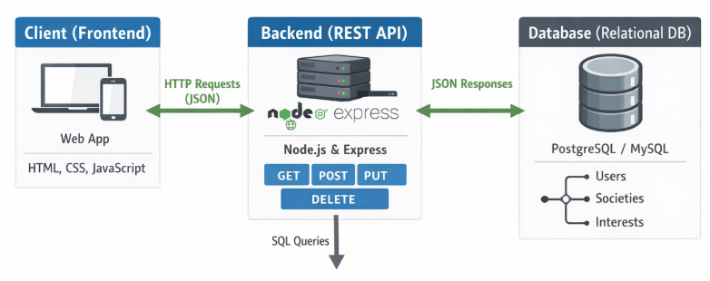
Web Service Implementation
Presenting Team Member: Abraham
System Architecture Overview
A web service enables different applications to communicate over the internet using standard protocols such as HTTP.
In this system, the web service acts as the backend, handling client requests, applying business logic, interacting with the database, and returning data in JSON format.
The service follows RESTful principles, using endpoints and HTTP methods (GET, POST, etc.) to access resources in a stateless and scalable way.

Slide 13
Web Service Implementation
Presenting Team Member: Student 3
Show some sample source code in this block for one or more endpoints/ routes which demonstrate how different resources can be accessed via the web service
If you wish to draw attention to multiple blocks of important code then use multiple slides / an embedded video
Use this as an opportunity for each student to demonstrate how they contributed towards the web service design / implementation
Each of you should demonstrate the learning outcome:
Demonstrate development skills through the planning and implementation of a sufficiently justified backend web service and effectively link this with a client system using an assortment of appropriate tools and techniques (e.g. leveraging web microframeworks for the backend, with client-side scripting in JavaScript)
Endpoint | HTTP Method(s)
/order | GET, POST, HEAD
/order/<orderNumber> | GET, POST, PUT, DELETE
… | …
… | …
… | …

Slide 14
Web Service Implementation
Presenting Team Member: Dan
Show some sample source code in this block for one or more endpoints/ routes which demonstrate how different resources can be accessed via the web service
If you wish to draw attention to multiple blocks of important code then use multiple slides / and embedded video
Use this as an opportunity for each student to demonstrate how they contributed towards the web service design / implementation
Each of you should demonstrate the learning outcome:
Demonstrate development skills through the planning and implementation of a sufficiently justified backend web service and effectively link this with a client system using an assortment of appropriate tools and techniques (e.g. leveraging web microframeworks for the backend, with client-side scripting in JavaScript)
Endpoint | HTTP Method(s)
api/v1/users/login | POST
api/v1/users/create | POST
api/v1/interests | GET
Api/v1/users/<id> | DELETE

Slide 15
Web Service Demo: Using Client frontend
Presenting Team Member: Zak
Here is where you would insert a demo video of the web service using the client frontend, if some elements of the client frontend are not complete then demonstrate these requests being made to the web service using an API testing tool such as Bruno

Slide 16
Evaluation and Reflection
This slide is hidden do not record on it, it is simply meant to divide the presentation template into sections
Notes:
Estimated time: 2-4 minutes

Slide 17
System Evaluation and Reflection
Presenting Team Member: Student 3
Present the results of any manual / automated testing performed on the system here and discuss them, a testing table or charts to visualise the results may be useful

Slide 18
System Evaluation and Reflection
Presenting Team Member(s): Student 1,2,3, 4 and 5
Critically reflect on the system which has been produced, linking in:
Reflections on the requirements as identified in previous submissions (did anything change?)
Consider how planning and design helped you to consider aspects of the system before the implementation (and what didn’t you consider in hindsight)
Consider what major positives and negatives you would draw from evaluating your implementation
How would you improve things in the future?
How would you improve your development process in the future?
with the evaluation results

Slide 19
Advice and Guidance
This slide is hidden do not record on it, it is simply meant to divide the presentation template into sections
Notes:
Further advice and guidance regarding this will be released in the coming weeks.
In the meantime, consider that the video is an opportunity to present the most valuable contributions of each group member to the project, each group member should be able to demonstrate they have contributed to both the database design / implementation and the web service / client design and implementation to demonstrate they have met the learning outcomes for the module.
Remember the assessment asks that you demonstrate the four learning outcomes throughout the module:
Identify, document, and model the planning and design requirements for a given backend web service, by leveraging appropriate software engineering technique
Design and construct a well justified and appropriate Database architecture, using an appropriate assortment of query languages and tools on a host DBMS (e.g. SQL for RDBMS system, GQL/Cypher for GDBMS, etc).
Demonstrate development skills through the planning and implementation of a sufficiently justified backend web service and effectively link this with a client system using an assortment of appropriate tools and techniques (e.g. leveraging web microframeworks for the backend, with client-side scripting in JavaScript)
Evidence the ability to critique and evaluate the capabilities of the system, and defend the overall approach taken in terms of its suitability to meet an appropriate set of requirements (functional and non-functional).

